Slide 1

CPT Claim Process Study
- General Idea -
Contact:
Tang Totti(CI/DAV5.9)
Jin Jedy(CI/DAV5.9)
Zhao Elaine(CI/DAV5.9)
Zhang Xiang(CI/DAV5.9)
Version: 2020.11.20

Slide 2
Agenda
01
E2E Process Understanding
02
Draft Ideas
03
Next Action Plan
05
03
Notes:
Team

Slide 3
E2E Process Understanding
CPT Claim Process
Claim Registration
Claim Processing
Follow Up Actions
Consider different method of registration (e.g manual, web portal, mobile, voice recognition, etc)
Support both external partner and internal employee to raise claim request
Registration screen should be simple for external partner to maintain
Analyze claim request (e.g over-delivery, under-delivery, wrong delivery, etc)
Approval workflow is needed to confirm if claim process can be continued
Identify responsible team (who should afford the cost)
Confirm & trigger follow up actions
Goods return
Replacement
Credit/Debit memo
AAXAA process
…
Claim Monitoring
Monitoring process status, and communicate with customers
Analyze most frequent scenarios of claim request.
Both external partner and internal employee have this report
Knowledge based machine learning

Slide 4
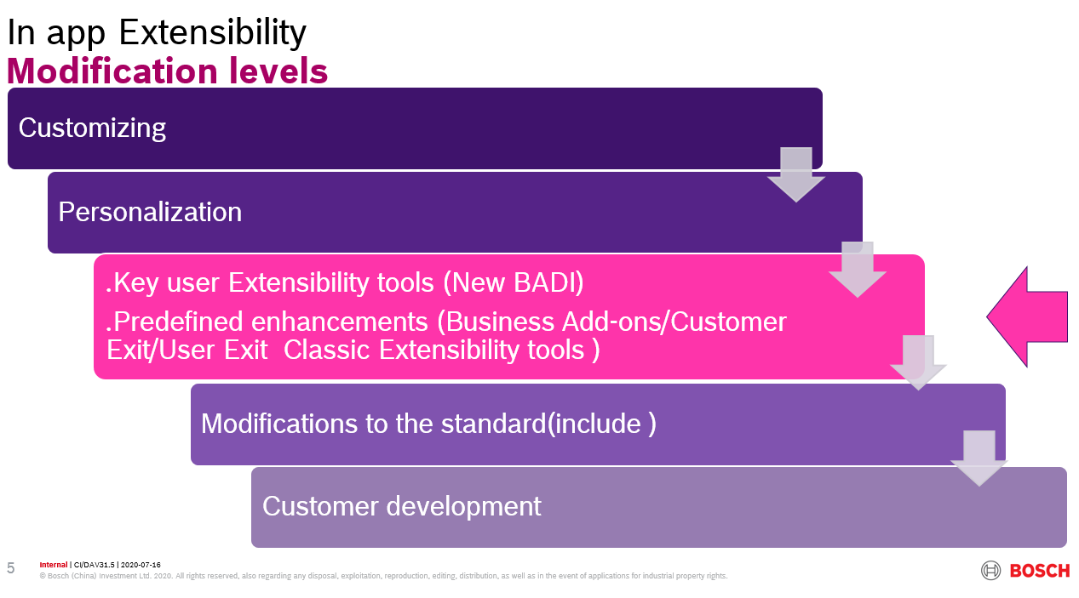
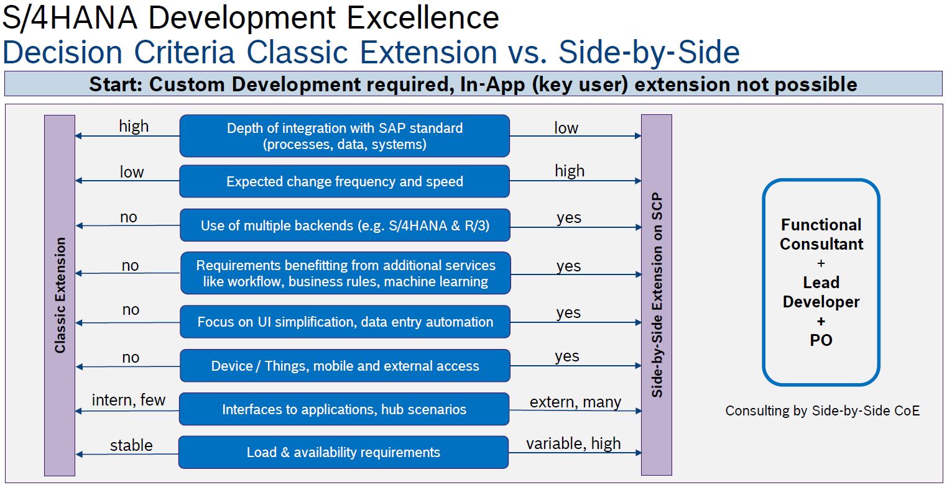
Draft Ideas
In-App Extensibility
CPT Claim Process
Side-by-Side Extensibility
3rd party solution
Customer Requirement
Key User Extensibility
Classic Extensibility
Applications on SCP
3rd party solution
Option A
Option B
Option C
Option D
Development via Key user extension tool
Re-design CQS solution
New development via Side by Side extensibility on SAP Cloud Platform
C/4HANA Cloud for Service

Slide 5

Option C – SBS development on SAP Cloud Platform
CPT Claim Process
Scenario 1 - Preprocessing Applications
Applied into step “claim registration”, “claim processing”, etc.
Scenario 2 – Analytic Applications
Applied into step “claim monitoring”, etc.
SAP Fiori Launchpad
SAP Fiori Launchpad
Database Table
Custom User Interface
(SAPUI5)
Custom User Interface
(SAPUI5)
Restful API
Service
(JAVA | JS | CDS)
Restful API
Service
(JAVA | JS | CDS)
Secure Tunnel
OData Service
OData
Secure Tunnel
Database Table
Application
(ABAP | CDS)
Secure Tunnel
Database Table
Database Table
SAP
In-App Extensibility
Side-by-Side Extensibility

Slide 6








Option D – C/4HANA Cloud for Service
CPT Claim Process
Self-service
Customer-service
Onsite-service
Feedback Management
Website and online Portal
Robot self-service
Online community
Answer from knowledge base
Mobile apps/SDK
E-business
Fee calculation and payment on line
Communication/reminding/e-mail etc.
Common queue & AI routing
Agent desktop
Scheduling and dispatch
Mobile onsite service
AI order
Mobile consumer service
Taking response/feedback/action in time
Customer survey
UX survey and analysis
Mobile consumer service
Knowledge & Learning
Service order & Incident
Integration
Service core
Research help
Knowledge share and collaboration
Online community
Learning & Training
Service order
Incident management
Service order management
Workflow and rule engine
Workflow and template customizing
IOT platform
Predictive maintenance and service
Remote diagnose and service
Contract management
Warranty management
Remote diagnose and service
Parts management

Slide 7
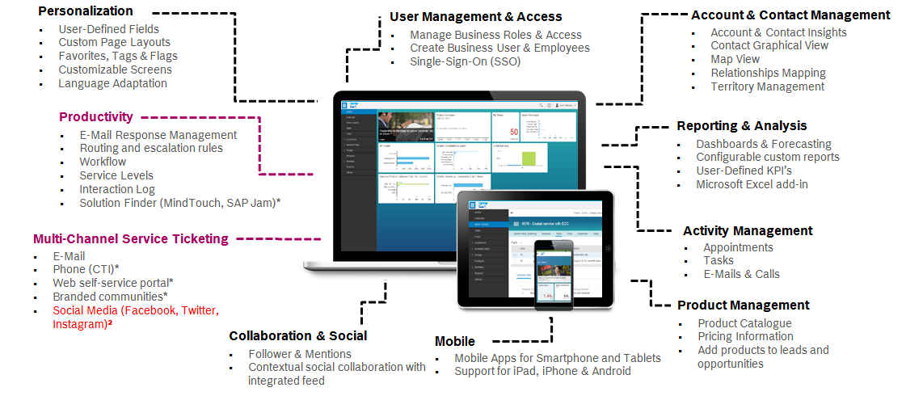
Option D – C/4HANA Cloud for Service
CPT Claim Process

Slide 8
Action Plan
CPT Claim Process
No. | Action Point | Responsible | Nov. 2020 | Dec. 2020 | Jan. 2021 | Feb. 2021 | Mar. 2021
1 | Requirement Analysis
1.1 | Available LH Document(Link) analysis | Jin Jedy
1.2 | Further missing requirement follow up | Jin Jedy
2 | Existing CQS Solution Study
2.1 | Investigate background for existing CQS design | Jin Jedy
2.2 | Gap analysis between available requirement and existing solution | Jin Jedy
3 | New Process & Solution Design
3.1 | Option C: SBS development on SAP Cloud Platform | Jin Jedy
3.2 | Option D: C/4 Cloud service investigation | Zhao Elaine
4 | Communication & Collaboration
4.1 | Keep updates of UD progress and planning | Tang Totti
4.2 | Regular exchange with CPT team | Tang Totti

Slide 9
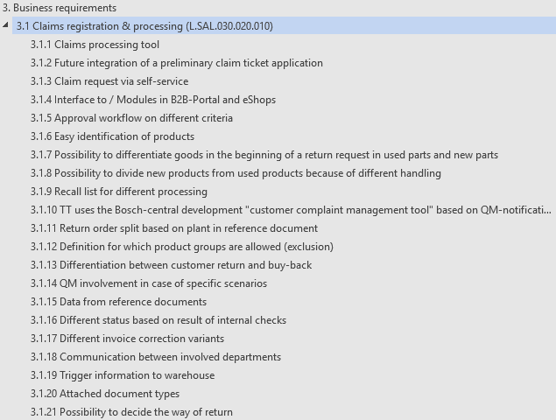
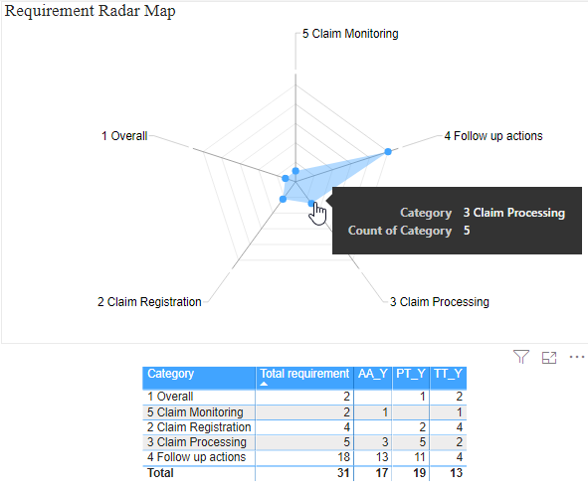
Requirement analysis
Action Plan
Available LH Document analysis & Further missing requirement follow up
Claim Monitoring

Slide 10
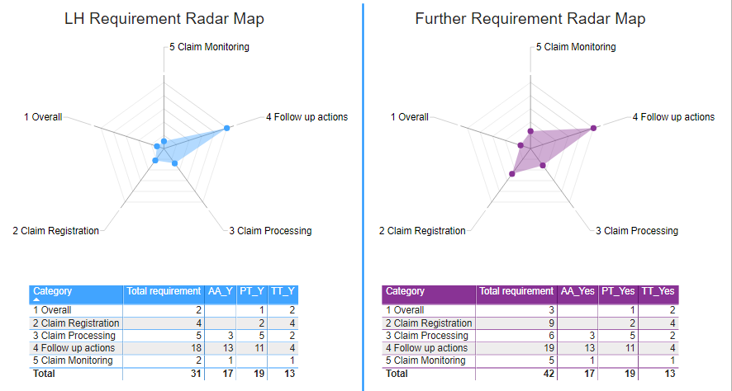
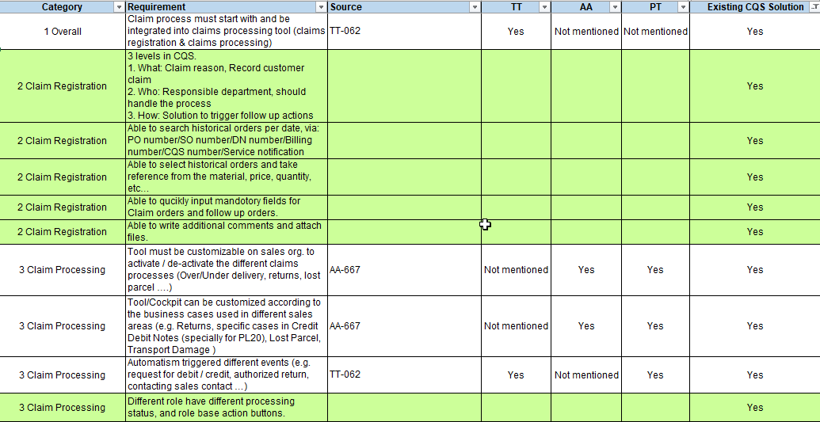
Existing CQS solution study
Action Plan
Investigate background for existing CQS design, gap analysis between available requirement and existing solution

Slide 11
New process & solution design
Action Plan
Option C: New Side by Side development on SAP Cloud Platform
Working together with Side by side team, cover front-end and back-end development
Prototype via one scenario(Over-delivery based on PT)
Customer
Customer Service Center
SBO
Warehouse
APP 1
APP 2
Raise request(ext.)
Raise request(Int.)
No
Order Wrongly?
Yes
APP 3
Review request
Confirm request
Further check reason
Trigger follow up action
APP 4
APP 5
Status Checking
Analytic Report

Slide 12
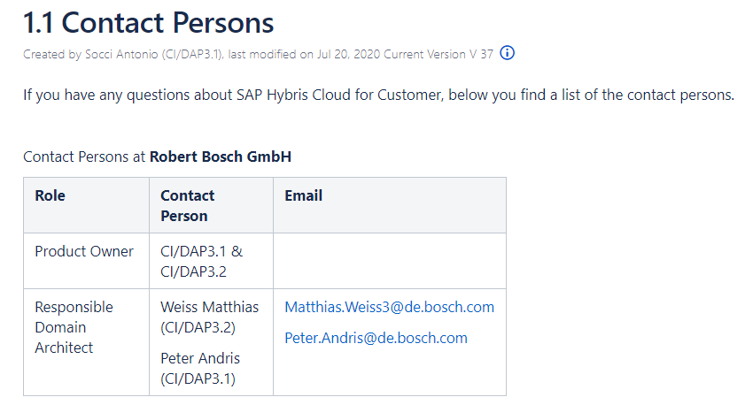
New process & solution design
Action Plan
Option D: C/4 Cloud service investigation
Bosch C/4HANA responsible team: CI/DAP3.1 & CI/DAP3.2
C/4 Main functions investigation
Matrix between requirement and C/4 functions
Design a sample scenario end to end
Step1: Claim engagement –Choose one path(Such as web portal or WeChat)
Step2: Create claim order
Step3: Pre-analysis of claim order
Step4: Trigger workflow involve different departments to solve the issue
Step5: Trigger integration between C4 and SAP ERP to create subsequent orders
Step6: Close the claim order
Step7: Do the customer survey of the service quality
Key Link
C/4HANA Cloud Service@Bosch
SAP Could for Customer(SAP Help Portal)

Slide 13
Communication and collaboration
Action Plan
Keep updates of UD progress and planning
Contact window: Richter Ellen (GS/PSD6)
Follow up on new updates from user department
Remind UD about missing requirement based on process study and design
Question: From UD, what’s the understanding of CN CI team involvement? keep CI updates? Or existing solution support?
Regular exchange with CPT team
Contact window: Zyznowski Marcin (CI/DAV5.2) & Woerthmann Simon (CI/DAV51)
Monthly exchange meeting for updates and idea
Question: what’s the expectation from CPT team?
2021.03 ~ 06 – Solution Proposal with prototype (CN team provide)
2021.08? – Decision (CPT team make decision)
2022.12 – Delivery

Slide 14
Capacity Plan
Action Plan
Name | Nov. 2020 | Dec. 2020 | Jan. 2021 | Feb. 2021 | Mar. 2021
Tang Totti | 4 | 4 | 4 | 3 | 6
Jin Jedy | 4 | 4 | 4 | 3 | 6
Zhao Elaine | 4 | 4 | 6 | 3 | 6
Zhang Xiang | 2 | 2 | 2 | 2 | 3
SbS team (Frontend & Backend) | 0 | 8 | 8 | 6 | 8

Slide 15
Thank you

